Slide 1
Correspondences between protein sequence and structure
Basic concepts | 10 min
- Sequence-structure relationship
Protein folding prediction Intrinsic disorder prediction
Structure and disorder prediction | 15 min
Template-based structure prediction
- Intrinsically disordered regions prediction
Q&A | 5 min

Slide 2
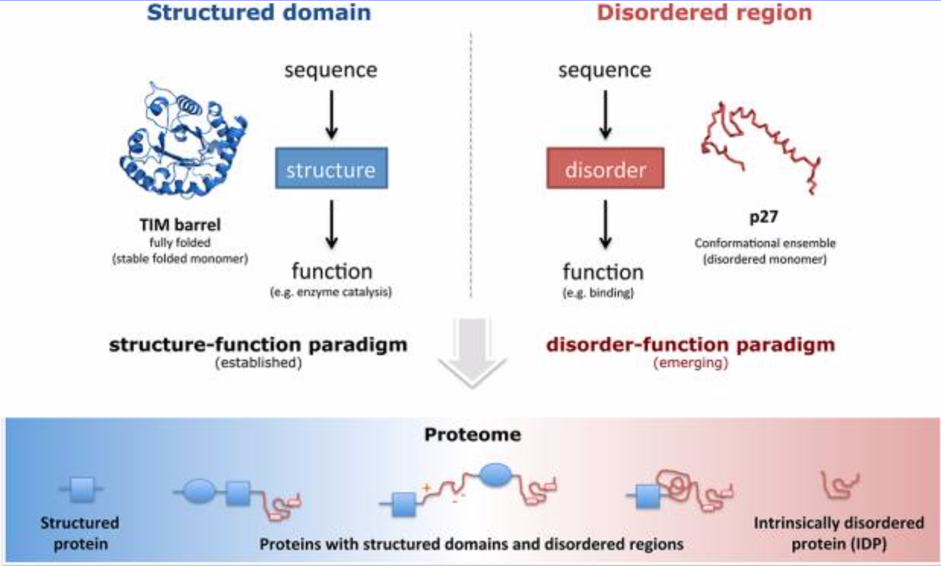
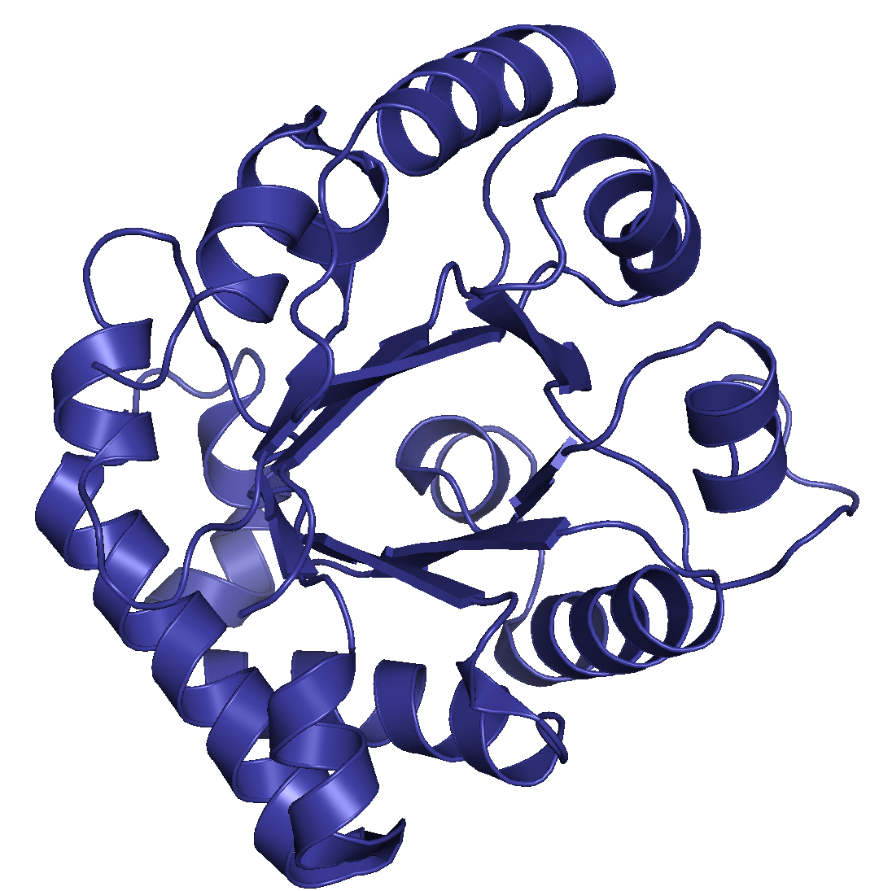
Sequence-structure relationship
In the 1960s, Christian Anfinsen postulated that the unique three-dimensional structure of a protein is determined by its amino acid sequence (sequence–structure–function paradigm). However, intrinsically disordered proteins and regions does not conform to this postulate. Disordered regions contribute to protein function and do not fold into a defined tertiary structure.
Babu M. The contribution of intrinsically disordered regions
to protein function, cellular complexity, and human
Disease. Biochemical Society Transactions. 2016. 44:1185–1200. doi: 10.1042/BST20160172
Adapted from van der Lee et al. Classification of Intrinsically Disordered Regions and Proteins. Chem. Rev. 2014. 114: 6589−6631. doi: 10.1021/cr400525m
Notes:
While most proteins and polypeptide segments fold co-operatively into defined three-dimensional structures, numerous studies, primarily over the last couple of decades, have discovered that a large number of polypeptide segments do not fold into defined tertiary structure. Instead, they adopt an ensemble of different conformations and can still carry out their function in an unstructured/disor- dered state [3–6]. These studies are now establishing the disorder–function paradigm (Figure 1B), which states that certain polypeptide segments can be functional without achieving a defined tertiary structure [7–15].
The Critical Assessment of Structure Prediction (CASP) is a community-wide experiment, which designs to benchmark the state-of-the-art of protein structure prediction in every two years since 1994. Our lab has participated as "Zhang-Server" in the automated structure prediction section since 2006, which the method has been consistently ranked at the top in the experiments (Table 1). The results of recent CASP experiments can be found at Protein Structure Prediction Center.
https://www.ncbi.nlm.nih.gov/pmc/articles/PMC2443096/
Two powerful conclusions followed from Anfinsen’s work. First, it enabled the large research enterprise of in vitro protein folding that has come to understand native structures by experiments inside test tubes rather than inside cells. Second, the Anfinsen principle implies a sort of division of labor: Evolution can act to change an amino acid sequence, but the folding equilibrium and kinetics of a given sequence are then matters of physical chemistry.

Slide 3


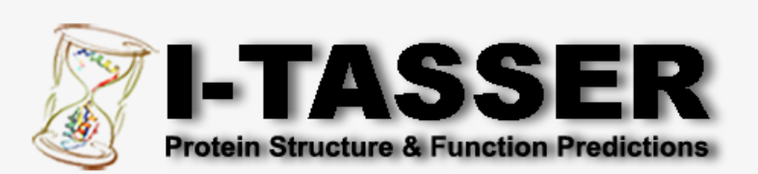
How can we predict protein folding?
Template-free (or de novo or ab initio)
Template-based (or homology-modeling)
They do not use any known structures. Useful when not a single structure in a protein family is known.
Use the similarity to another protein whose three-dimensional structure is known.
PDB ID: 1R2T Triose-phosphate isomerase (TIM). Aparicio R, Ferreira S, Polikarpov I. J Mol Biol. 2003. 334: 1023-1041. DOI: 10.1016/j.jmb.2003.10.022
doi: 10.1016/S0076-6879(04)83004-0
doi: 10.1093/nar/gki408
doi: 10.1093/nar/gkv342
Kuhlman B, Bradley P. Advances in protein structure prediction and design. Nature Reviews Molecular Cell Biology. 2019. 20:681–697.
Notes:
Error!!!!!!!! Threading is used as other category in some schemes!!!!!!
Protein structure prediction aims to determine spatial location of every atom in a protein molecule from the amino acid sequence by computational calculations.
Huge fiel
Zki page 5:
Generally speaking, structure prediction techniques fall into three categories: ab initio prediction, protein threading [or sometimes referred as fold recognition (FR)], and homology modeling (12). Ab initio methods make structure predic- tions without using any structural information of previously solved protein structures; instead, they are entirely based on the first principles of physics. Structure prediction by homology modeling is based on accurate sequence alignments between a query protein and a template protein with solved struc- tures; hence, the prediction accuracy of this class of methods heavily depends on the sequence similarity between two proteins. Protein threading represents a more general class of prediction techniques than homology modeling as it uses both sequence similarity information when exists and structural fitness information between the query protein and the template structure. Although homology modeling has been mainly used for detailed (e.g., all heavy-atom) structure prediction when a query protein has a close homolog in the Protein Data Bank (PDB) (13), protein threading is often used for FR and backbone structure prediction when a query protein might have only remote structural homologs or analogs in PDB. We have noticed that the boundaries among these three classes of prediction techniques have started to become blurred because scientists have started to integrate the strengths of different methods to make their prediction methods more effective and more generally applicable (14).
Methods for the prediction and design of protein structures have advanced dramatically in the past decade. Increases in computing power and rapid growth in the protein sequence and structure databases have fuelled the development of new data- intensive and computationally-demanding approaches for structure prediction.
https://www.nature.com/articles/s41580-019-0163-x?proof=t
Template-based modelling
The steps in standard template-based modelling include selection of a suitable structural template; alignment of the target sequence to the template structure; and molecular modelling to account for mutations, insertions and deletions present in the target–template alignment. Closely related templates can be detected by using single-sequence search methods such as BLAST²⁸ to scan the PDB sequences. To detect more distantly related templates, a target sequence profile^{29,30} built from a multiple-sequence alignment can be used to scan a database of sequence profiles for proteins of known structure by profile–profile comparison^{31,32} or can be matched to a library of structural templates to assess sequence–structure compatibility^{33,34}. Template selection methods return an initial target–template alignment that can be adjusted manually, often in an iterative manner after model building. Given an alignment to a template, established tools^{35,36,37} can be used to quickly construct molecular models of the target sequence by performing side-chain optimization only at mutated positions and by rebuilding the backbone around insertions and deletions. For target protein sequences that are only distantly related to proteins of known structure, more sophisticated approaches that rely on multiple templates and perform aggressive backbone conformational sampling may be required^{37,38,39}. Together with available crystal structures, template-based modelling approaches can provide structural information for roughly two-thirds of known protein families⁴⁰.
Template-free modelling
Template-free modelling approaches can be applied to proteins without global structural similarity to a protein in the PDB. Lacking a structural template, these methods require a conformational sampling strategy for generating candidate models, as well as a ranking criterion by which native-like conformations can be selected. The structure prediction process without a template (Fig. 2) typically begins with the construction of a multiple-sequence alignment of the target protein and related sequences. The sequences of the target and its homologues are then used to predict local structural features, such as secondary structure and backbone torsion angles, and non-local features, such as residue–residue contacts or inter-residue distances across the polypeptide chain. These predicted features guide the process of building 3D models of the target protein structure, which are then refined, ranked and compared with one another to select the final predictions.

Slide 4
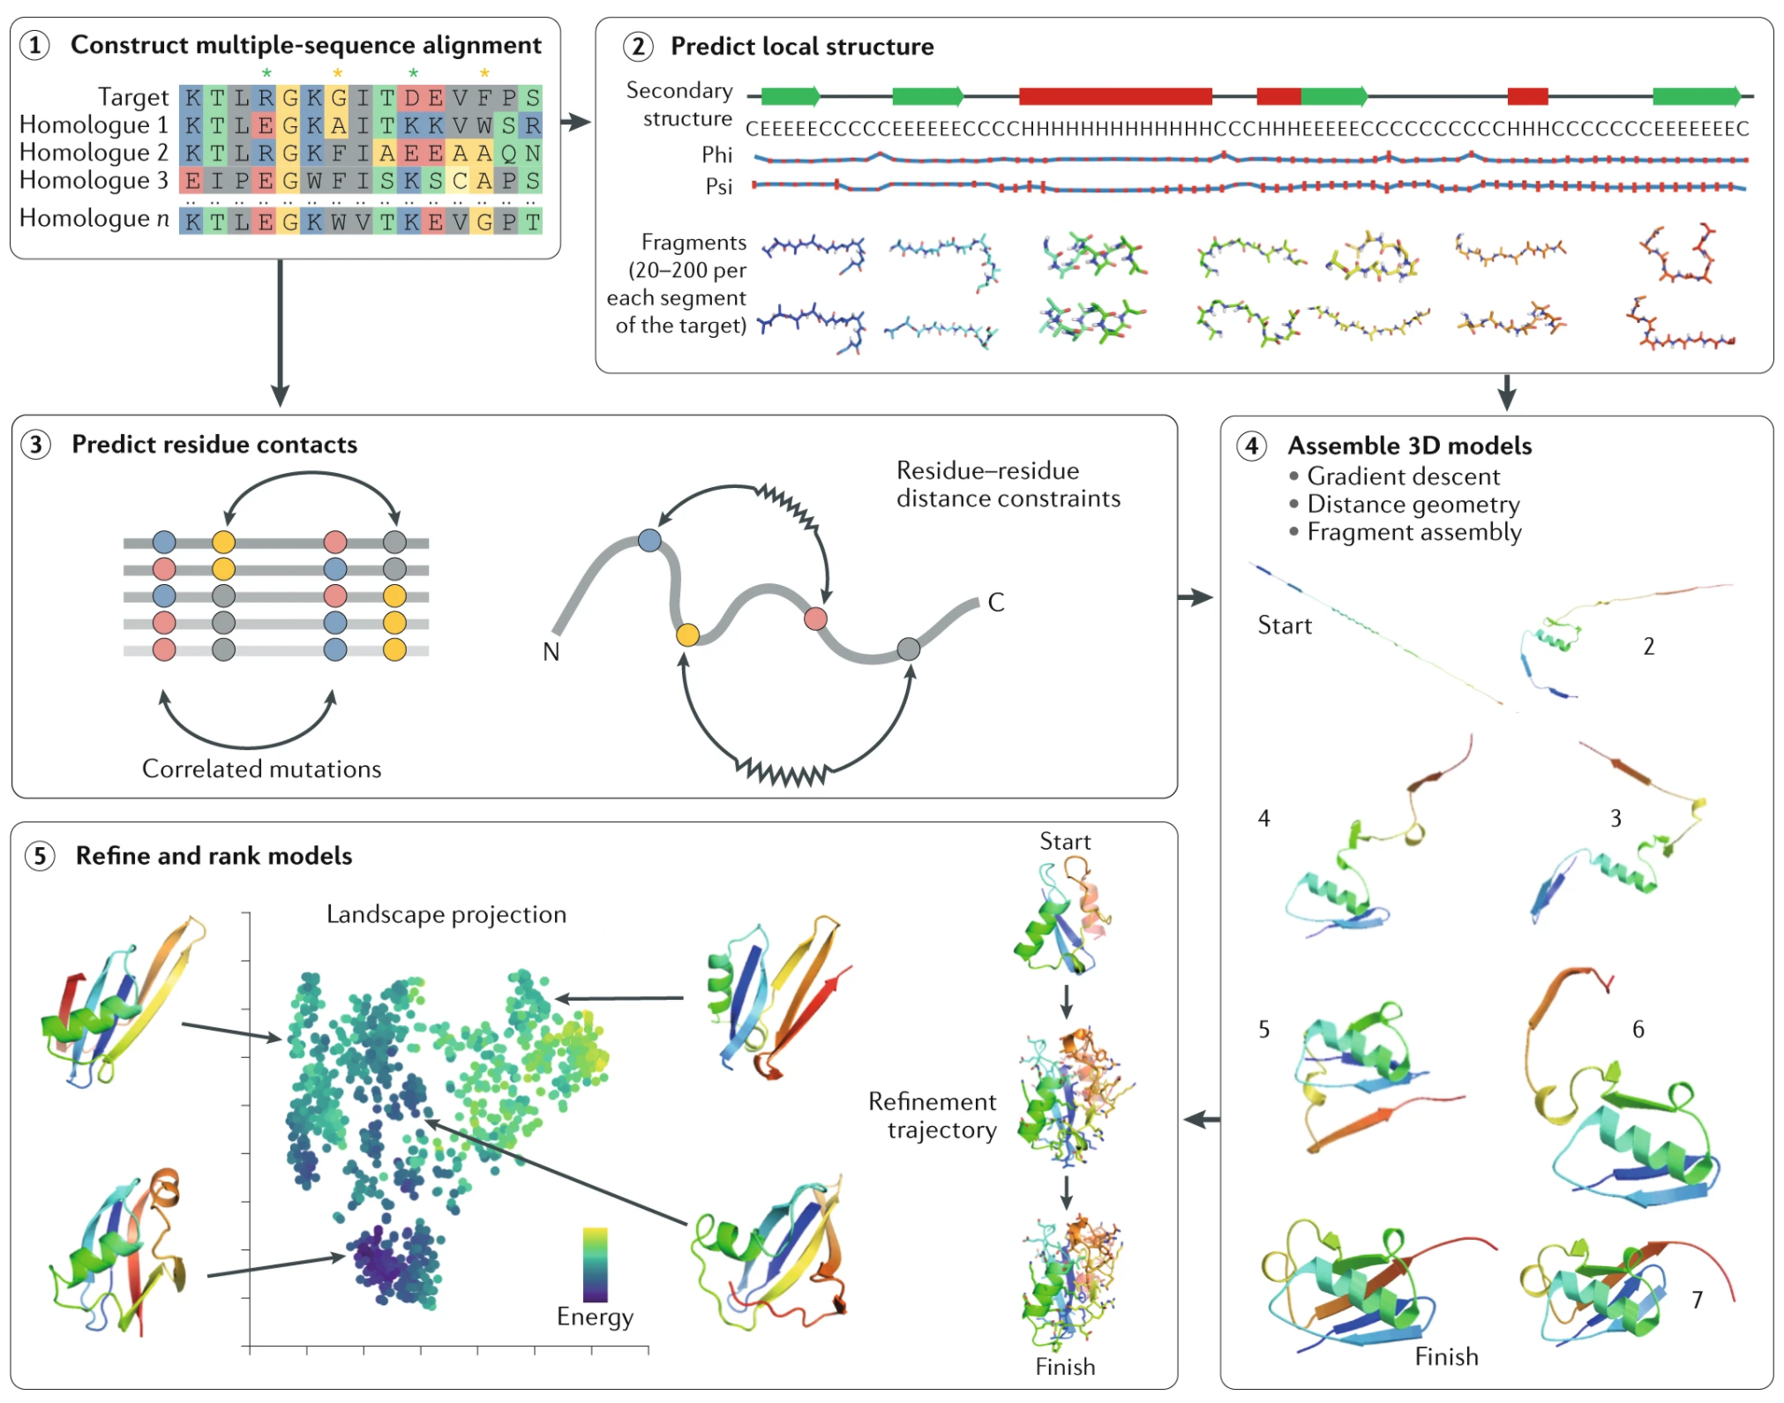
Template-free (de novo) folding prediction
Typically begins with the construction of a multiple-sequence alignment of the target protein and related sequences. The sequences of the target and its homologues are then used to predict local structural features, such as secondary structure and backbone torsion angles, and non-local features, such as residue–residue contacts or inter-residue distances across the polypeptide chain. These predicted features guide the process of building 3D models of the target protein structure, which are then refined, ranked and compared with one another to select the final predictions.
Kuhlman B, Bradley P. Advances in protein structure prediction and design. Nature Reviews Molecular Cell Biology. 2019. 20:681–697.
Notes:
Template-free modelling
Template-free modelling approaches can be applied to proteins without global structural similarity to a protein in the PDB. Lacking a structural template, these methods require a conformational sampling strategy for generating candidate models, as well as a ranking criterion by which native-like conformations can be selected. The structure prediction process without a template (Fig. 2) typically begins with the construction of a multiple-sequence alignment of the target protein and related sequences. The sequences of the target and its homologues are then used to predict local structural features, such as secondary structure and backbone torsion angles, and non-local features, such as residue–residue contacts or inter-residue distances across the polypeptide chain. These predicted features guide the process of building 3D models of the target protein structure, which are then refined, ranked and compared with one another to select the final predictions.
An accurate multiple-sequence alignment between the target protein and its sequence homologues contains valuable information on the amino acid variation between the homologous sequences, including correlated patterns of sequence changes occurring at different positions (the green and yellow stars highlight pairs of alignment columns displaying amino acid charge and size swapping, respectively) (step 1). The target sequence and the multiple-sequence alignment form the basis for predictions of local backbone structure, including torsion angles (phi and psi predictions are shown, with red error bars indicating uncertainty) and secondary structure (step 2; PSIPRED⁶⁷ predictions are shown). Libraries of backbone fragments taken from proteins predicted to have similar local structures can also be assembled for use in model building. The multiple-sequence alignment can be used to predict residue pairs likely to be in spatial contact on the basis of observation of correlated mutations in pairs of alignment columns (step 3). These predictions of local structure and residue contacts guide 3D model building with techniques such as gradient-based optimization, distance geometry or fragment assembly (step 4; snapshots from a Rosetta⁴² fragment assembly trajectory are shown). Initial 3D models are typically built with a reduced representation and a coarse-grained energy function; to better determine near-native predictions, these models are refined with an all-atom energy function and compared with one another to identify clusters of similar low-energy conformations, from which representative models are chosen as the final predictions (step 5; a 2D principal-component projection of the space of refined models is shown, in which each dot represents a single model).
https://www.nature.com/articles/d41586-019-01357-6
Kryshtafoych CASP 2019prot.25823.pdf
By definition, all free modeling targets are cases where no tem- plate structure can be easily detected from sequence. But there may nevertheless be similar folds already known. An alternative approach to using predicted contacts as restraints is to survey a library of known structures, assessing which, if any, are most compatible with the contact set. Figure S3 shows the dependency of backbone accu- racy on the nearness of structural templates. Both CASP 12 and 13 show clear dependency, but it is substantially reduced in CASP13, suggesting that template searches were less competitive with folding algorithms, probably because greater contact accuracy and the use of more general inter-residue distance prediction made the latter approach more effective.
The major progress in modeling domains and monomeric proteins without direct use of a structural template is a very significant break- through: for these proteins, the long-standing problem of “protein folding” (generating a model with the correct topology) is essentially solved, albeit it in way that early work in the field never imagined. An alignment with of at least a few dozen sequences is usually needed for the methods to work, but most protein families are now that large. Success with topology prediction has increased focus on the remaining problems—we are still a long way from the accuracy of X- ray structures or from enabling structure-based drug design, and more complex structures are the norm in biology. CASP already has well- established categories in the relevant areas, particularly refinement and protein assemblies, and as already noted it will be exciting to see what impact deep learning and related approaches have on those. Other areas, such as conformational change in response to ligand binding and environmental conditions, remain future challenges.
Protein structure prediction
There are two general approaches to predicting the structure of a protein of interest (the ‘target’): template-based modelling, in which the previously determined structure of a related protein is used to model the unknown structure of the target; and template-free modelling, which does not rely on global similarity to a structure in the PDB and hence can be applied to proteins with novel folds. Historically, the methods applied in these two approaches have been quite distinct, with template-based modelling focusing on detection of, and alignment to, a related protein of known structure, and template-free modelling relying on large-scale conformational sampling and application of physics-based energy functions. Recently, however, the line between these approaches has begun to blur, as template-based methods incorporate energy-guided model refinement, and template-free methods employ machine learning and fragment-based sampling approaches to exploit information in the structural database (though template-based methods still retain an increased accuracy for targets with detectable sequence similarity to the entries in the PDB). Here we provide a brief introduction to template-based modelling methods, and then turn to template-free modelling and describe recent developments in this area.

Slide 5
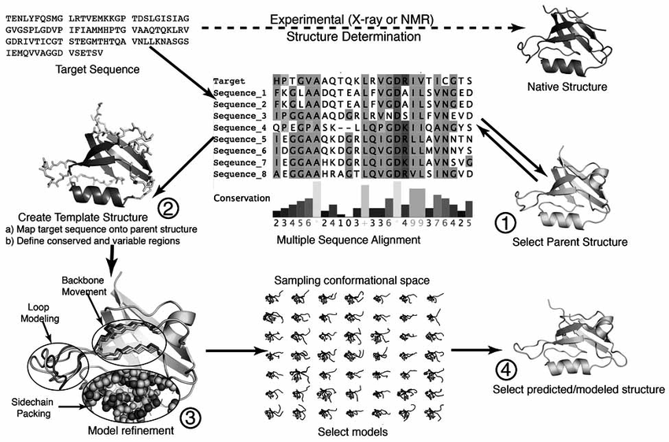
Template-based (or homology model building)
The steps in standard template-based modelling include selection of a suitable structural template; alignment of the target sequence to the template structure; and molecular modelling to account for mutations, insertions and deletions present in the target–template alignment.
Together with available crystal structures, template-based modelling approaches can provide structural information for roughly two-thirds of known protein families.
Kuhlman B, Bradley P. Advances in protein structure prediction and design. Nature Reviews Molecular Cell Biology. 2019. 20:681–697.
Xiaotao Q, Rosemarie S, Ryan D, Jerry Ti. A Guide to Template Based Structure Prediction. Current Protein & Peptide Science. 2009. 10:270-285. doi: : 10.2174/138920309788452182
Notes:
Template-based modelling
The steps in standard template-based modelling include selection of a suitable structural template; alignment of the target sequence to the template structure; and molecular modelling to account for mutations, insertions and deletions present in the target–template alignment. Closely related templates can be detected by using single-sequence search methods such as BLAST²⁸ to scan the PDB sequences. To detect more distantly related templates, a target sequence profile^{29,30} built from a multiple-sequence alignment can be used to scan a database of sequence profiles for proteins of known structure by profile–profile comparison^{31,32} or can be matched to a library of structural templates to assess sequence–structure compatibility^{33,34}. Template selection methods return an initial target–template alignment that can be adjusted manually, often in an iterative manner after model building. Given an alignment to a template, established tools^{35,36,37} can be used to quickly construct molecular models of the target sequence by performing side-chain optimization only at mutated positions and by rebuilding the backbone around insertions and deletions. For target protein sequences that are only distantly related to proteins of known structure, more sophisticated approaches that rely on multiple templates and perform aggressive backbone conformational sampling may be required^{37,38,39}. Together with available crystal structures, template-based modelling approaches can provide structural information for roughly two-thirds of known protein families⁴⁰.
Typically, structure templates do not provide complete coverage of a target structure, and overall accuracy depends not only on the appropriateness of the templates but also on modeling of regions with no template. As Figure 7 shows, by this measure, there was modest

Slide 6
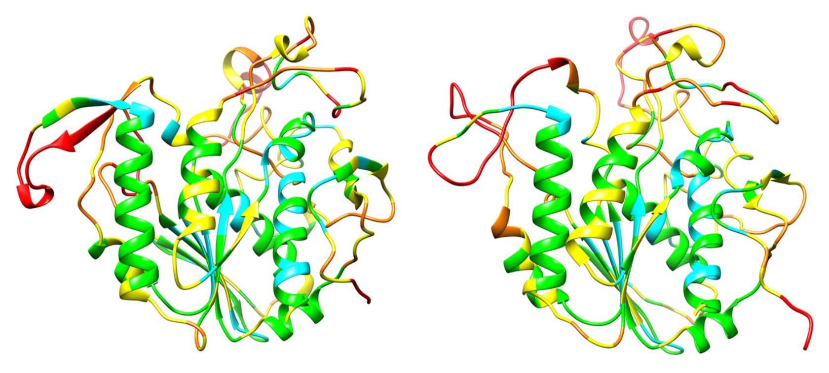
CASP (Critical Assessment of Structure Prediction)
Created in 1994, CASP is a community wide experiment to determine and advance the state of the art in modeling protein structure from amino acid sequence.
The most recent CASP13 (2018) saw a dramatic progress in template-free modeling by using deep learning techniques to predict inter-residue distances. With the proviso that there are an adequate number of sequences known for the protein family, the new methods essentially solve the long-standing problem of predicting the fold topology of monomeric proteins.
X-ray structure of Xylan acetyltransferase (unknown for the participants in CASP)
Most accurate CASP model by template-free modeling
Kryshtafovych A, Schwede T, Topf M, Fidelis K, Moult J. Critical assessment of methods of protein structure prediction (CASP)—Round XIII. 2019. doi:10.1002/prot.25823.
Notes:
https://www.predictioncenter.org/casp13/zscores_final.cgi?model_type=first&gr_type=server_only!!!!!!
Huge field developing rapidly (deborha)
The Critical Assessment of Structure Prediction (CASP) is a community-wide experiment, which designs to benchmark the state-of-the-art of protein structure prediction in
This brief introduction to the protein folding problem would not be complete without a reference to CASP (Critical Assessment of protein Structure Prediction, http:// predictioncenter.org/), a project aimed at monitoring progress in computerized protein structure prediction tools.
Modeling proteins with no or marginal similarity to existing structures (ab initio, new fold, non-template or free modeling) is the most challenging task in tertiary structure prediction
While CASP11 saw the advent of evolutionary couplings in contact pre-
diction, in CASP12 these methods matured mostly by coupling the
coevolution information with machine learning.
Part of the three-dimensional accuracy improvement in CASP13 comes from not only more accurate prediction of contacts but also prediction of inter-residue distances at a range of thresholds, some- thing deep neural networks are capable of and the statistical methods are not.
Detailed description of the experiment
CASP (Critical Assessment of Structure Prediction) is a community wide experiment to determine and advance the state of the art in modeling protein structure from amino acid sequence. Every two years, participants are invited to submit models for a set of proteins for which the experimental structures are not yet public. Independent assessors then compare the models with experiment. Assessments and results are published in a special issue of the journal PROTEINS. In the most recent CASP round, CASP13, nearly 100 groups from around the world submitted more than 57,000 models on 90 modeling targets (see Critical assessment of methods of protein structure prediction (CASP) - Round XIII).
https://www.predictioncenter.org/casp13/zscores_final.cgi?model_type=first&gr_type=server_only
For a quarter of a century,8 attempts have been made to predict three-dimensional contacts between residues in proteins, based on correlations in amino-acid substitutions found in protein family pro- tein sequence alignments.9
FIGURE 4 Crystal structure of a 354 residue domain of a free modeling target (T0969-D1), ESKIMO 1, a probable xylan acetyltransferase, PDB 6CCI (left panel) and the most accurate CASP model (right panel). Most of the structure core is modeled to a Cα accuracy of better than 1 (cyan) or 2 Angstroms (green). Irregular loop regions are less accurate (yellow, better than 4 Angstroms or orange, up to 8 Angstroms error). Some residues (red) in external loops have larger errors
Part of the three-dimensional accuracy improvement in CASP13 comes from not only more accurate prediction of contacts but also prediction of inter-residue distances at a range of thresholds, some- thing deep neural networks are capable of and the statistical methods are not.

Slide 7
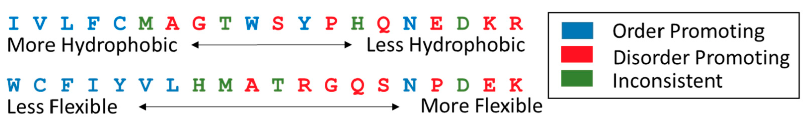
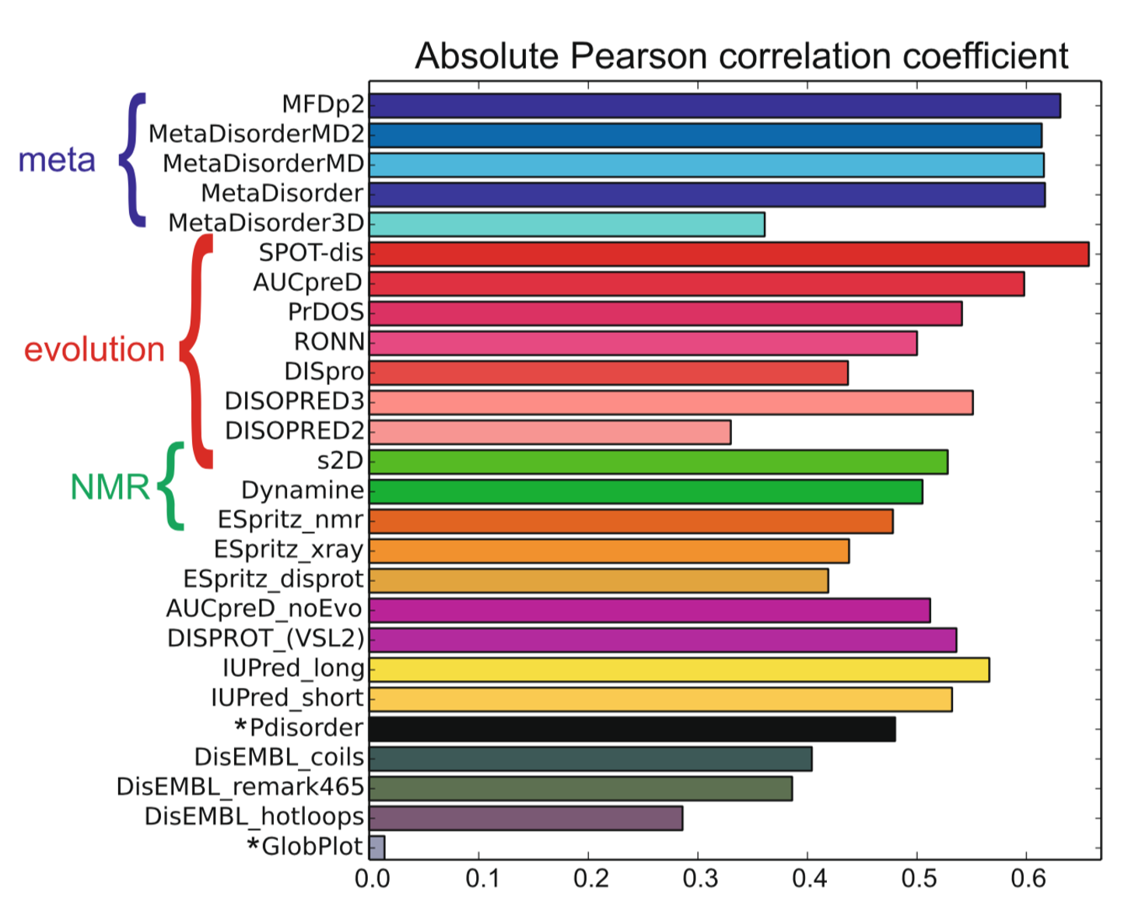
Intrinsic Disorder Prediction
The distinct sequence features that are present in IDPs and IDRs allow the construction of sequence based rules that can facilitate high performance disorder prediction.
DeForte S, Uversky V. Order, Disorder, and Everything in Between. Molecules. 2016. 21,1090. doi:10.3390/molecules21081090.
Ranking of disorder prediction methods according to the absolute Pearson linear correlation coefficient between estimated disorder probability and Z-score.
Nielsen J, Mulder F. Quality and bias of protein disorder
Predictors. Scientific Reports. .2019. 9:5137. doi.org/10.1038/s41598-019-41644-w
Notes:
Ranking of disorder prediction methods according to the absolute Pearson linear correlation coefficient between estimated disorder probability and Z-score
An accumulation of experimental evidence has corroborated the early notion that ID can be inferred from sequencefeatures,firstsuggestedbyRJWilliams1​0.​ ​Sincethen,dozensofIDpredictionmethodsbased ondifferentprinciplesandcomputingtechniqueshavebeenpublished1​1,​ suchas​VSL2B1​2,​ DisEMBL1​3,​ DISOPRED1​ 4,​ IUPred1​ 5,​ Espritz​16 and many others. ​Annotations related to ID both predicted and derived from experimental evidence are stored in a variety of dedicated databases, each focusing on particular aspects of the ID spectrum, namely DisProt1​ 7,​ MobiDB1​ 8,​ IDEAL​19,​ DIBS​20 and MFIB2​ 1.​ Over the last few years, ID annotations are also provided in some of the most important core data resources like InterPro2​ 2,​ UniProt2​ 3​ and PDBe2​ 4.​
The frequency of amino acids in disordered proteins significantly differs from that of ordered proteins (Dunker et al. 2001; Uversky, Gillespie, and Fink 2000a; Tompa 2002). Amino acid frequencies plotted as a function of the flexibility index of residues (Vihinen, Torkkila, and Riikonen 1994) show a distinctive pattern (Figure 10.1): IDPs are depleted in amino acids of low flexibility indexes and are enriched in amino acids of high flexibility indexes (Dunker et al. 2008). Amino acids in the former group (Trp, Cys, Phe, Ile, Tyr, Val, and Leu) are termed order-promoting, whereas those in the latter (Ala, Arg, Gly, Gln, Ser, Pro, Glu, and Lys) are disorder-promoting. The physical ratio- nale of this trend comes from the ensuing high net charge and low net hydrophobicity, which ensure the extended state of IDPs (see Chapter 9, Section 9.2.2)”(Tompa, 2010)
The problem of predicting protein ID is challenging for several reasons. The first is in the definition of ID, which is a term that indicates that the sequence of a protein does not encode a stable structural state that is ordered. Defining ID as a property that a protein does not have (i.e. order) implies that many conformational states fit the definition, covering a continuum between fully disordered states and folded stateswithlongdynamicregions3​6,37.​ Thesecondproblem,whichfollowsfromthefirst,isthatwedonot yet have a consensus reference experimental method, or set of experimental methods, to characterize ID (as we have X-ray crystallography to define ordered structures), so we lack a clear operational definition of ID. The third problem is that disorder is more context-dependent than structure, so it is

Slide 8
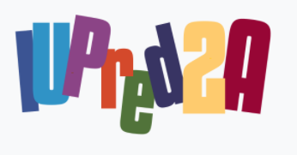
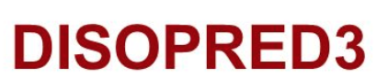

Strategies of Intrinsic Disorder Prediction
Three general prediction strategies currently exist:
Sequence properties | Estimation residue interaction energies. Sequences with lower predicted pairwise interaction energies are considered more likely to be disordered due to a lack of stabilizing contacts.
Machine learning | Use of training sets for machine learning. For instance: unresolved residues in X-ray structures; linear support vector machines (SVMs) trained on PSI-BLAST sequence profiles surrounding unresolved residues.
Meta-predictors | Combine several individually successful disorder prediction methods have been developed more recently, resulting in increases in prediction accuracy
doi:10.1093/nar/gky384
doi: 10.1093/bioinformatics/btu744
https://doi.org/10.1093/nar/gkx1071
van der Lee et al. Classification of Intrinsically Disordered Regions and Proteins. Chem. Rev. 2014. 114: 6589−6631. doi: 10.1021/cr400525m
Notes:
Agregar mas crecientes predctores!!!!! =)
Disorder prediction based directly on sequence proper- ties. For instance, IUPred is a physicochemical sequence- based method that estimates residue interaction en- ergies.411 Sequences with lower predicted pairwise interaction energies are considered more likely to be disordered due to a lack of stabilizing contacts. Similarly, FoldIndex considers weakly hydrophobic regions of high net charge. Such regions are likely to be disordered due to their low energy benefit when adopting a compact conformation.31,412
Machinelearningisusedinthemajorityofpredictors,for example, by using unresolved residues in X-ray structures as a training set.410 For example, DISOPRED2 uses linear support vector machines (SVMs) trained on PSI-BLAST sequence profiles surrounding unresolved residues.35 Similarly, PONDR XL1 employs a feed-forward neural network trained on sequence attributes found associated with unresolved residues.271
Meta-predictors that combine several individually successful disorder prediction methods have been developed more recently, resulting in increases in prediction accuracy.407 For instance, metaPrDOS413 and MFDp414 both apply SVM-based machine learning to the results of a number of individual prediction methods to arrive at a final score. Similarly, the MobiDB401 and D2P2 databases49 (Box 1) provide a consensus overview of several independent prediction methods.

Slide 9
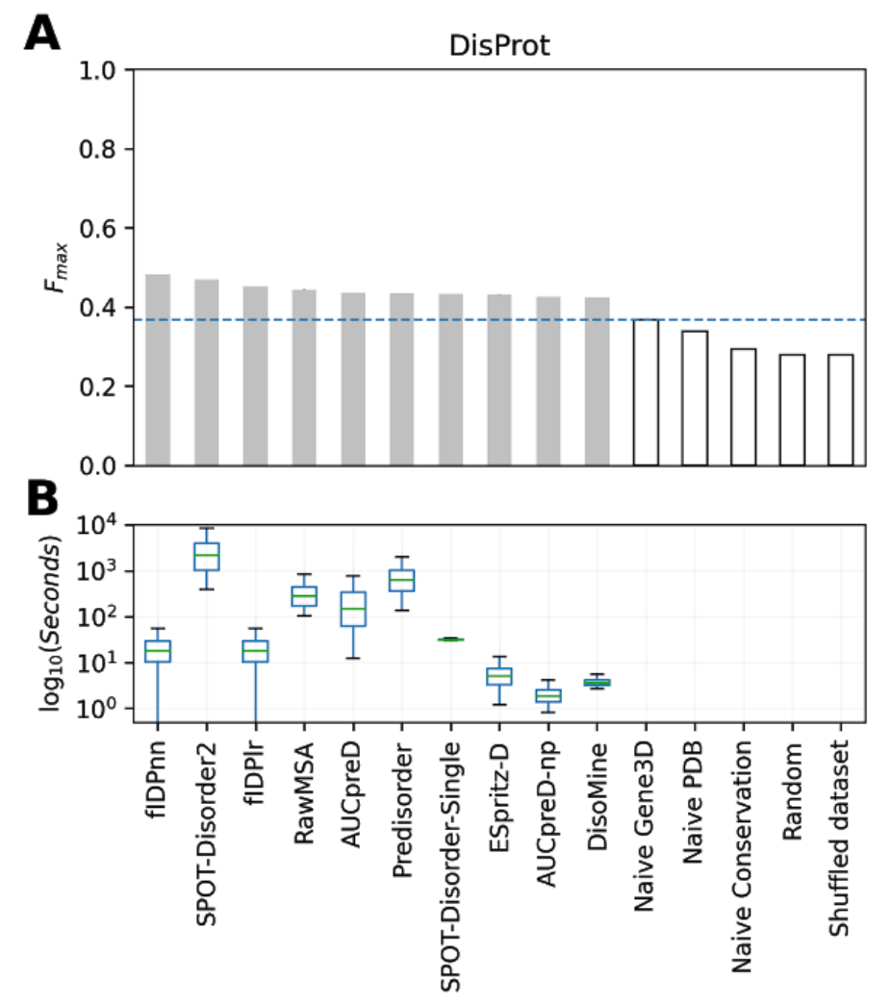
CAID (Critical Assessment of Intrinsic protein Disorder)
Created in 2018, CAID is a community wide experiment to determine and advance the state of the art in the detection of intrinsically disordered residues form the amino acid sequence.
CAID has two main prediction categories:
intrinsic structural disorder
binding sites found in IDRs (known as MoRFs, SLIMs or LIPs).
Necci M​, Piovesan D,​ CAID Predictors ​, DisProt Curators ​. Tosatto S. Critical Assessment of Protein Intrinsic Disorder Prediction. doi:10.1101/2020.08.11.245852
Performance of predictors for the top ten best ranking methods (A) and the distribution of execution time per-target (B).
Adapted from Necci M​, Piovesan D,​ CAID Predictors ​, DisProt Curators ​. Tosatto S. Critical Assessment of Protein Intrinsic Disorder Prediction. doi:10.1101/2020.08.11.245852
Notes:
Objective benchmarking of protein disorder prediction methods is essential before these can be used for further inferences. CASP (Critical Assessment of techniques for protein Structure Prediction) has been testing these predictors since 2002 (Melamud and Moult, 2003) and has tracked moderate progress since.CAID Inspired by CASP
http://disprotcentral.org/caid
!!!!!!agregar cuando fueron creados CASP y CAID
http://disprotcentral.org/caid
Critical Assessment of Intrinsic protein Disorder - CAID
The challenge
CAID is a community wide experiment to determine and advance the state of the art in the detection of intrinsically disordered residues form the amino acid sequence. Participants are invited to submit new software which is executed locally by the assessors and evaluated mainly on new experimental disorder evidence not yet available at the training time.

